Slide 1

Stage 1 Balance This, Hoser! Course Designer: Marcel Englmaier
Balance This, Hoser! is a 34 round, 170 point Comstock Long course. There are 14 IPSC targets and 6 steel targets. The best two hits per target will score. Steel must fall to score. The start signal is audible.
The Handgun start position is standing anywhere not touching the balance beams with wrists below belt. Handgun is loaded and holstered. The PCC start position is standing anywhere not touching the balance beams with PCC loaded, stock on belt, muzzle pointing down range.
On the audible start signal, engage all targets from on top of the balance beams

Slide 2
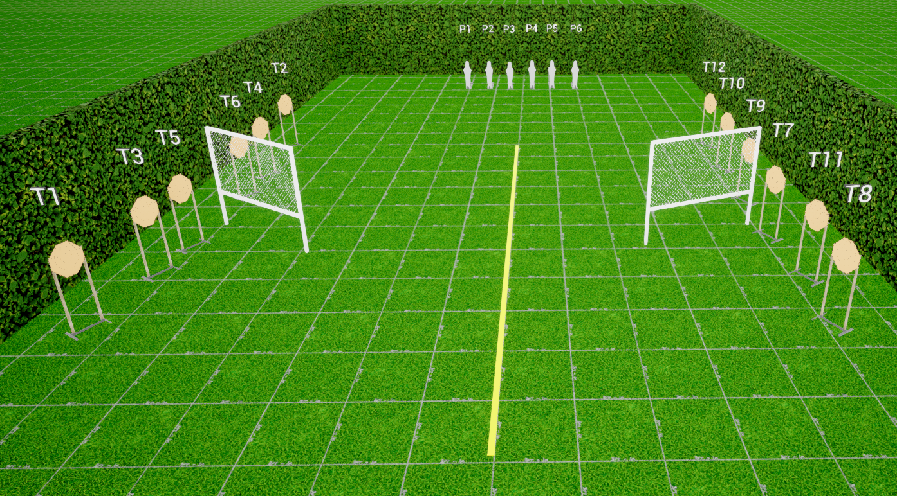
 | Stage 1 Balance This, Hoser! Course Designer: Marcel Englmaier

